Slide 1
Programming Fundamentals
By
Shazmeen Batool

Slide 2
Previous Lecture
Introduction to Control Statements
Boolean Data Type
If Statement

Slide 3
Today’s Lecture
Two way if else Statements
Common Errors in Control Statements

Slide 4
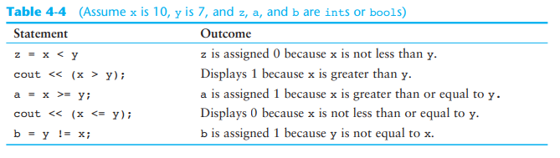
Class Activity
What will be the outcome of the statements below?

Slide 5
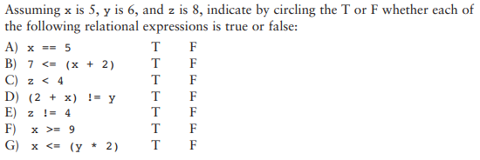
Class Activity

Slide 6
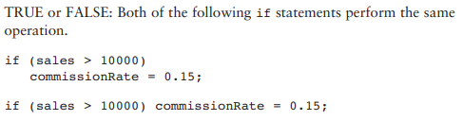
Class Activity
True

Slide 7
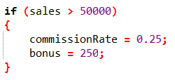
Class Activity
Write an if statement that performs the following logic: if the variable sales is greater than 50,000, then assign 0.25 to the commissionRate variable, and assign 250 to the bonus variable.

Slide 8
Two-Way if-else Statements
An if-else statement decides which statements to execute based on whether the condition is true or false.
Here is the syntax for a two-way if-else statement:
if (boolean-expression)
{
statement(s)-for-the-true-case;
}
else
{
statement(s)-for-the-false-case;
}

Slide 9
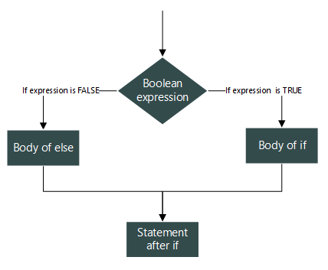
if-else statements
An if-else statement executes statements for the true case if the Boolean-expression evaluates to true; otherwise, statements for the false case are executed.

Slide 10
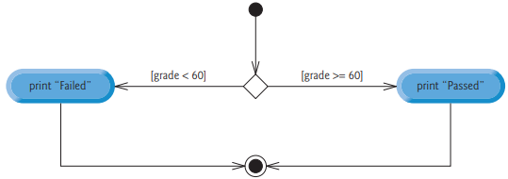

if-else statements Example
The pseudocode statement:
If student’s grade is greater than or equal to 60 Print “Passed” Else Print “Failed”
Flowchart:
If statement may be written in C++ as:

Slide 11
if-else statements Example
Write a code which display the area if radius is greater than equal to zero else print negative radius (Note: if radius is less than 0 no need to print any area only display negative radius).

Slide 12
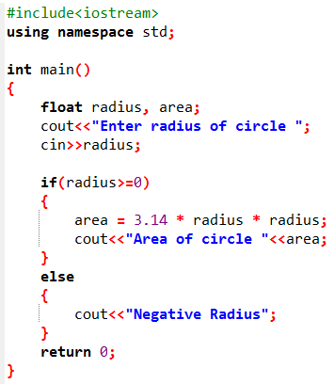


Output 1:
Output 2:

Slide 13
Common Errors
Common Error : Mistakenly Using = for ==
The equality testing operator is two equal signs (==). In C++, if you mistakenly use = for ==, it will lead to a logic error. Consider the code in next slide:

Slide 14
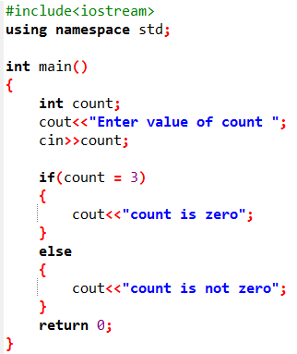


Common Errors
It always displays "count is zero", because count = 3 assigns 3 to count and the assignment expression is evaluated to 3. Since 3 is a nonzero value, it is interpreted as a true condition by the if statement. Recall that any nonzero value evaluates to true and zero value evaluates to false.
Output 1:
Output 2:

Slide 15
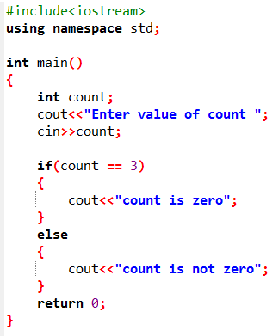


What is the output?
Output 1:
Output 2:

Slide 16

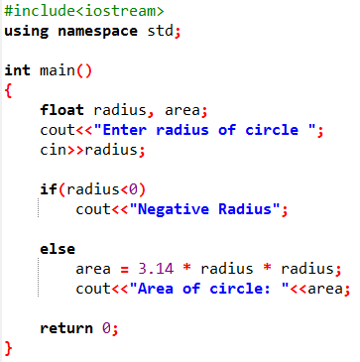

Activity 3: What’s wrong with the following code?
Write a code which display the area if radius is greater than equal to zero else print negative radius (note: if radius is less than 0 no need to print any area only display negative radius).

Slide 17
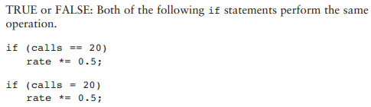
Class Activity
False

Slide 18
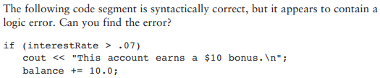
Class Activity
It contains a logic error due to the missing braces {} around the if statement's body.

Slide 19
Activity
Check Whether Number is Even or Odd using if else.

Slide 20
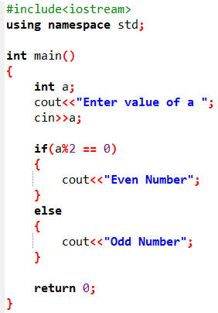


Output 1:
Output 2:

Slide 21
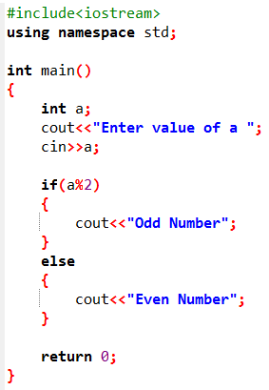
Class Activity
Understand this code to explain if statement
Output 1:
Output 2:

